Slide 1
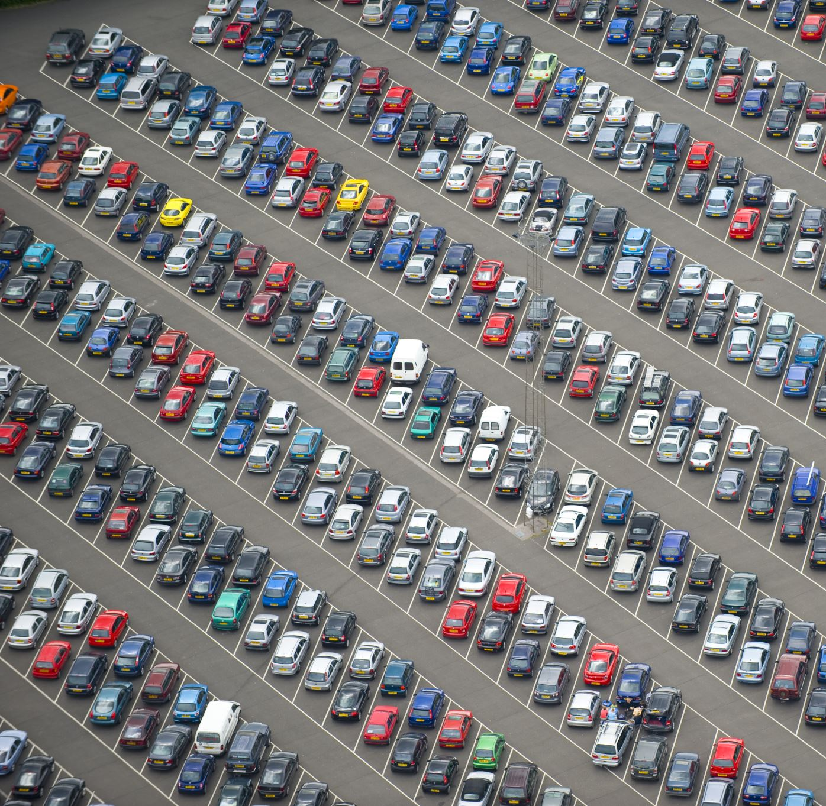
Car Sales Management System
Team: Data Camp
Shilpa
Ramya
Shubham

Slide 2
Objective:
The car sales management system dataset includes information about the different cars sold by dealers in a region of different cities. The dataset has been taken from Kaggle and generated mock data on mockaroo for the purpose of analyzing on how many cars are sold by a dealer in a region.
Through our dataset, for operational databases its managed by the dealership’s sales receptionist to keep a track of sales for different cars based on model, type in a city. When it comes to Analytical database the same data can be used by the sales management.
The analysis would help us know which of the top brands a dealer has, and a customer can get a good sale amount on the car.

Slide 3
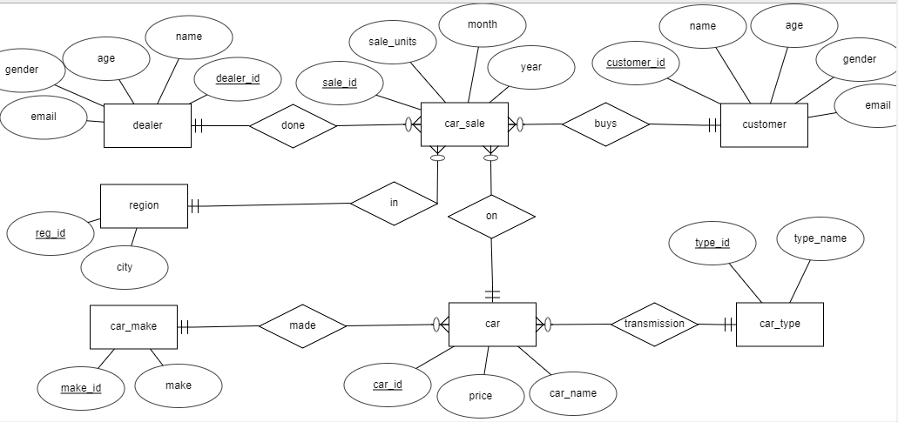
Operational Database (ER Diagram)

Slide 4
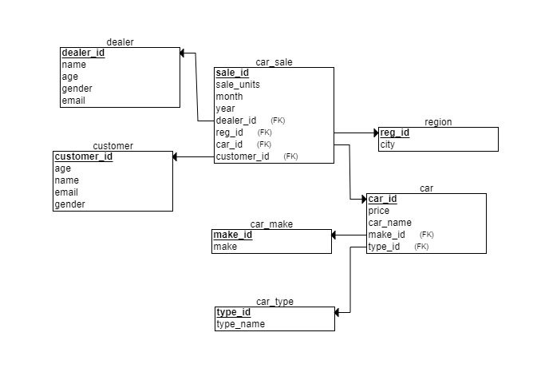
Relational Schema

Slide 5
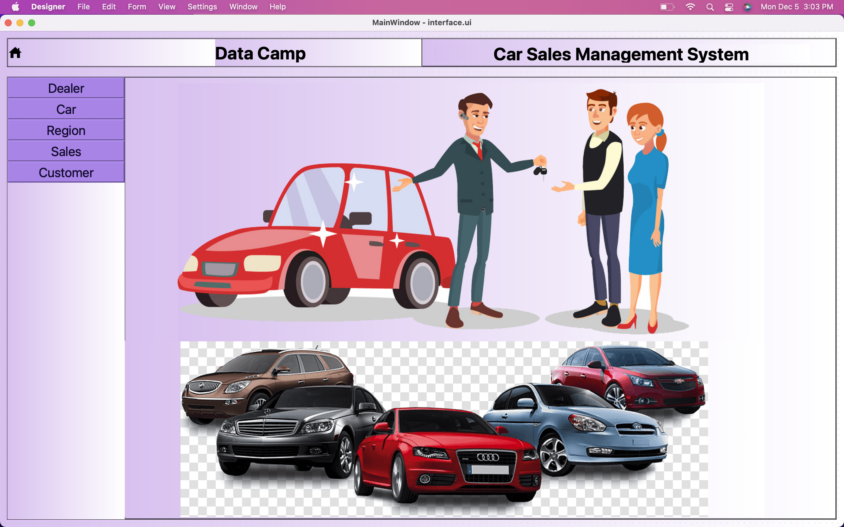
GUI can perform Insert, Update and Delete

Slide 6
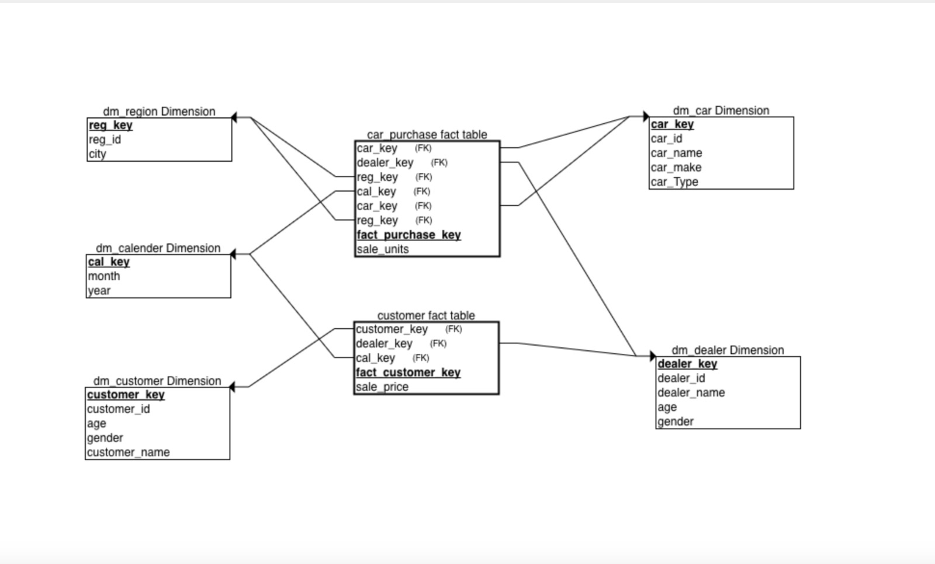
Analytical Database(Star Schema)

Slide 7
Thank You

